Slide 1


SAGE SCHOOL OF COMPUTER APPLICATION
Department of Computer Application
PBL Presentation on
RTLT – SAGE UNIVERSITY, BHOPAL
Under the Supervision of: Mr. Lokesh Sahu
Asst. Prof., Dept. of CA, SSOCA
Presented by:
Priyanshu Gour (221147)

Slide 2
Outline
Introduction
Literature Survey
Objective & Motivation
Problem Definition & Proposed Work
System Requirement & Snapshots of system
Conclusion And Future Work
Reference

Slide 3

Introduction
RTLT-Sage University, Bhopal
In this project RTLT(Real Time Location Tracking) person who visit first time this University can access each and every block in simple way by using our website RTLT.
By using this website person track location where he/she wants to go like blocks, department, parking area and other place under the University .

Slide 4

Literature Survey
Some website or apps are also existing like GoogleMap,
But this Website or Project based on particular Sage University Campus to find out each and every blocks, and helpful for those persons who visit University first time.

Slide 5

Objective & Motivation
The objective behind making this project was to make it easy for the newbies to quickly locate the place without much delay , thereby saving their time.
When we came to the college for the first time we found it difficult to navigate which caused a delay in reaching our desired location.
Also when we surveyed we were confronted with a fact that students pranked with outsiders and new students, deliberately directing them to other locations, which was directly or indirectly harmful for the reputation of our university.
This gave us the motivation to start working on this project so that we can help the people whether students or outsiders.

Slide 6

Problem Definition & Proposed Work
When we came to the college visit 1st time....We were facing many problems like to find out blocks, chambers ,labs etc. In our University. So I thought 💭 that many people are facing this problem. So we surveyed that is actually people faces this problem or not ? And we got this problem was faced by everybody.
So we thought 💭 for making it simple, We create a Website for helping those who came University first time .
After thinking of that using HTML, CSS, JAVASCRIPT, BOOTSTRAP and also using some API’s like mapbox, Google, Opencagedata, wheatherapi

Slide 7
SYSTEM REQUIREMENT
Operating system : Windows 8 or laterIf system is common
Processor : Intel Pentium 4 or late
Memory : 2 GB minimum, 4 GB recommended
Internet connection : Required

Slide 8

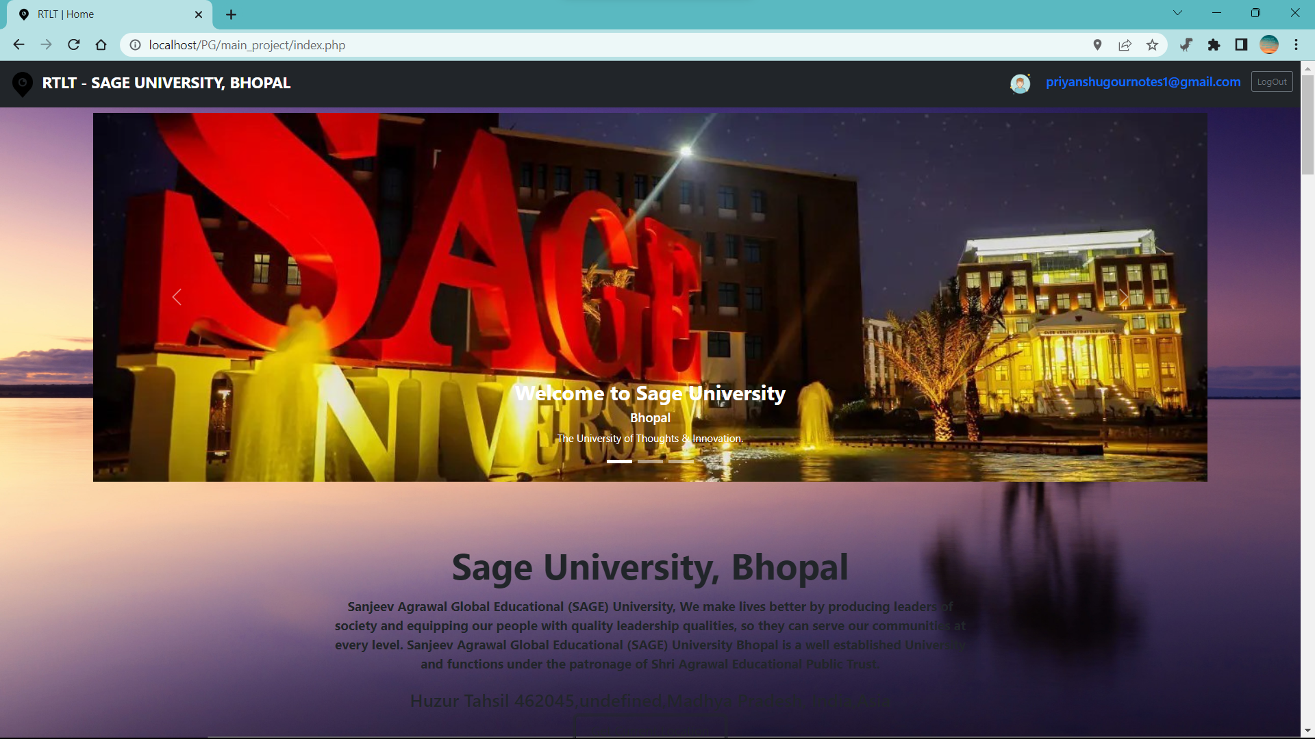
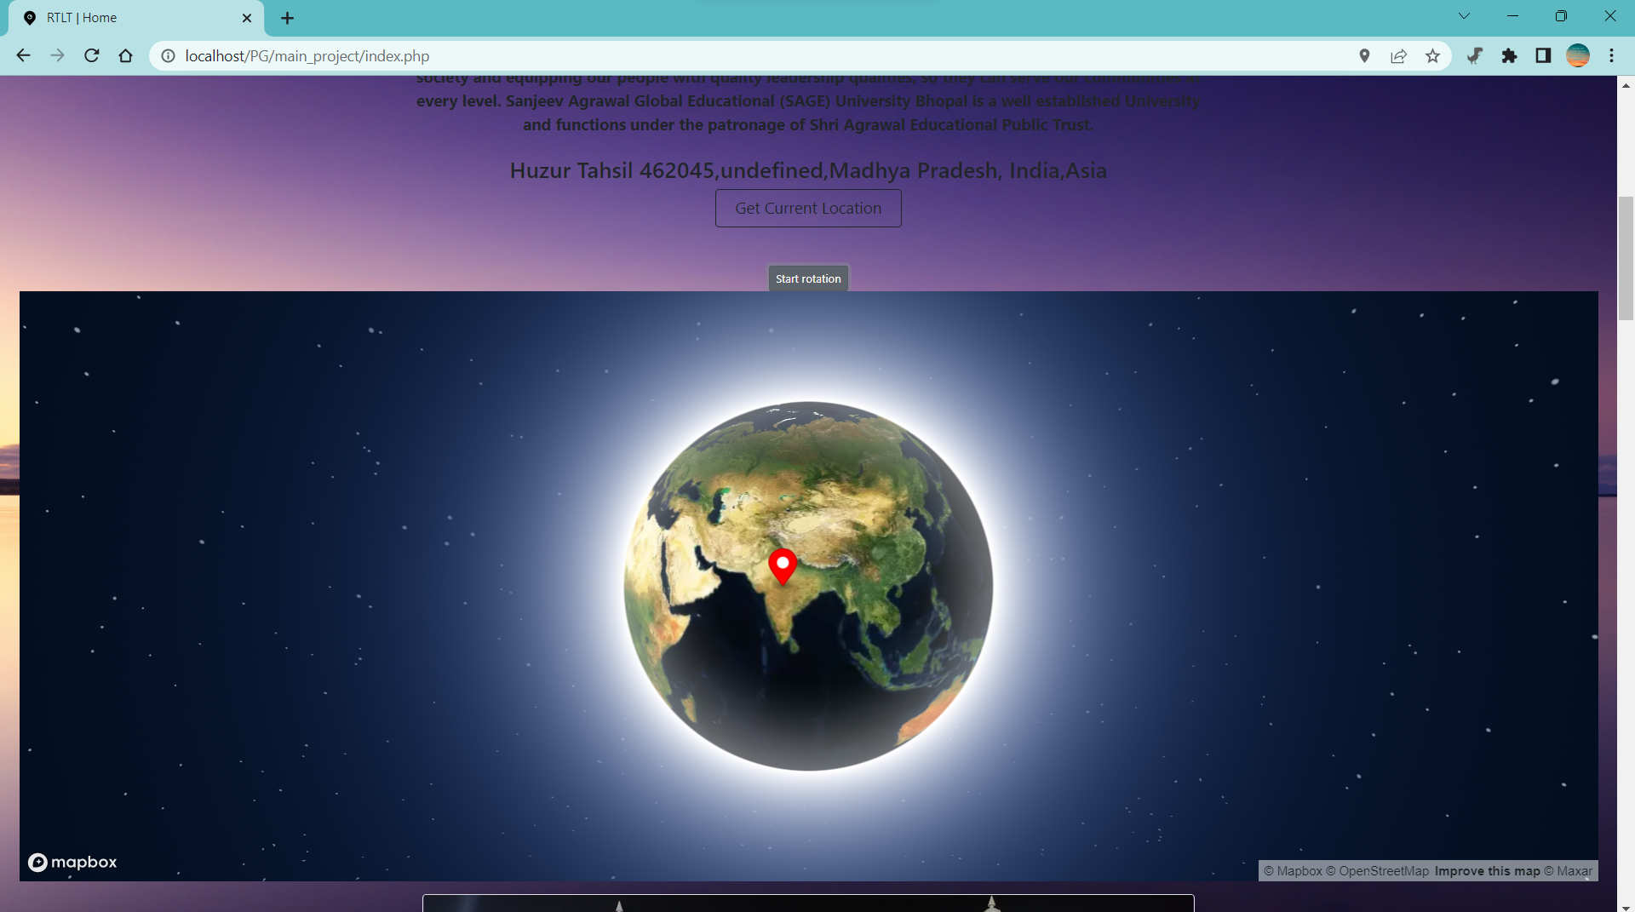
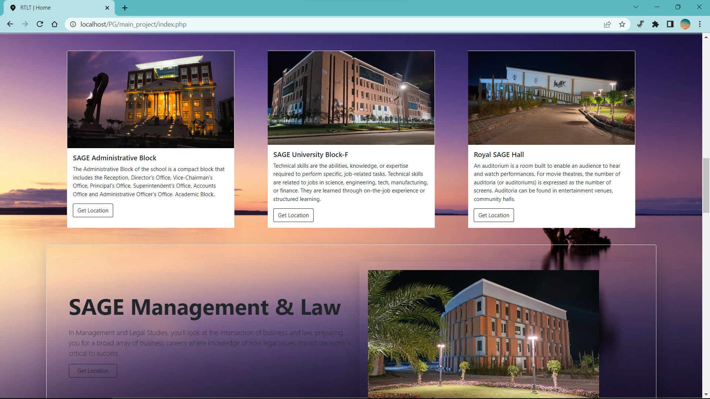
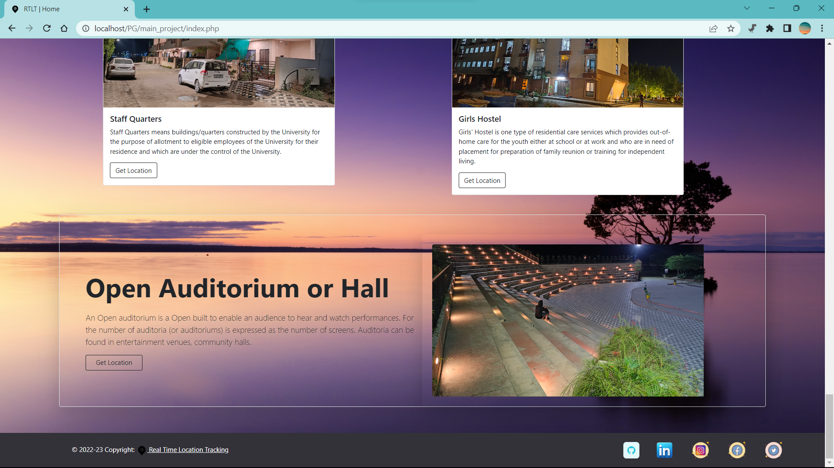
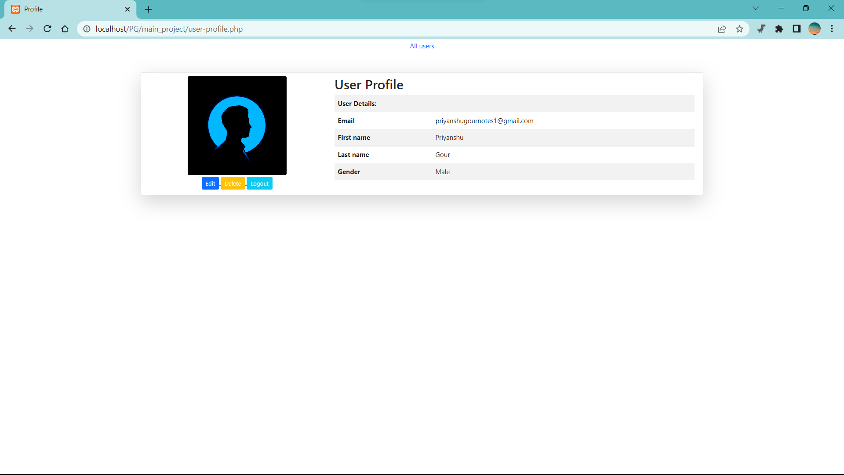
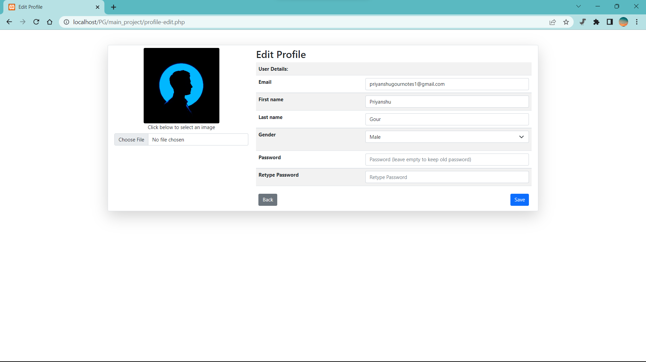
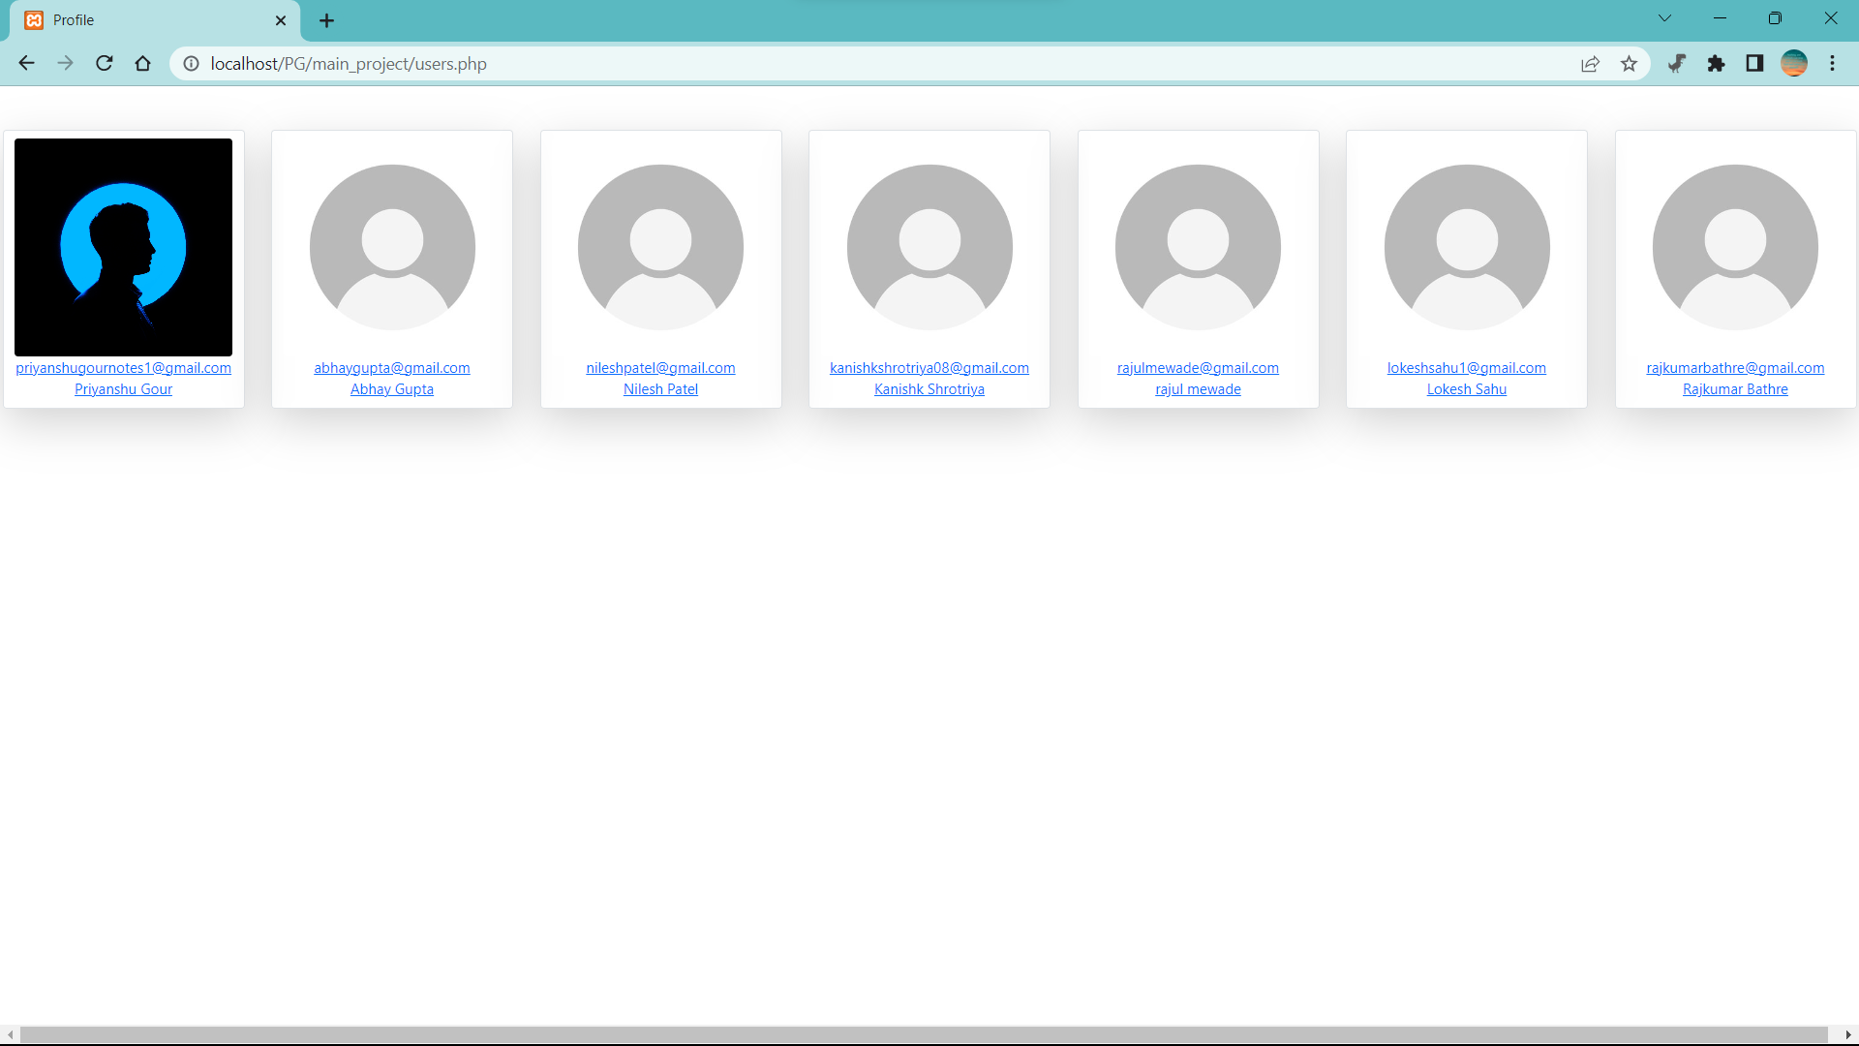
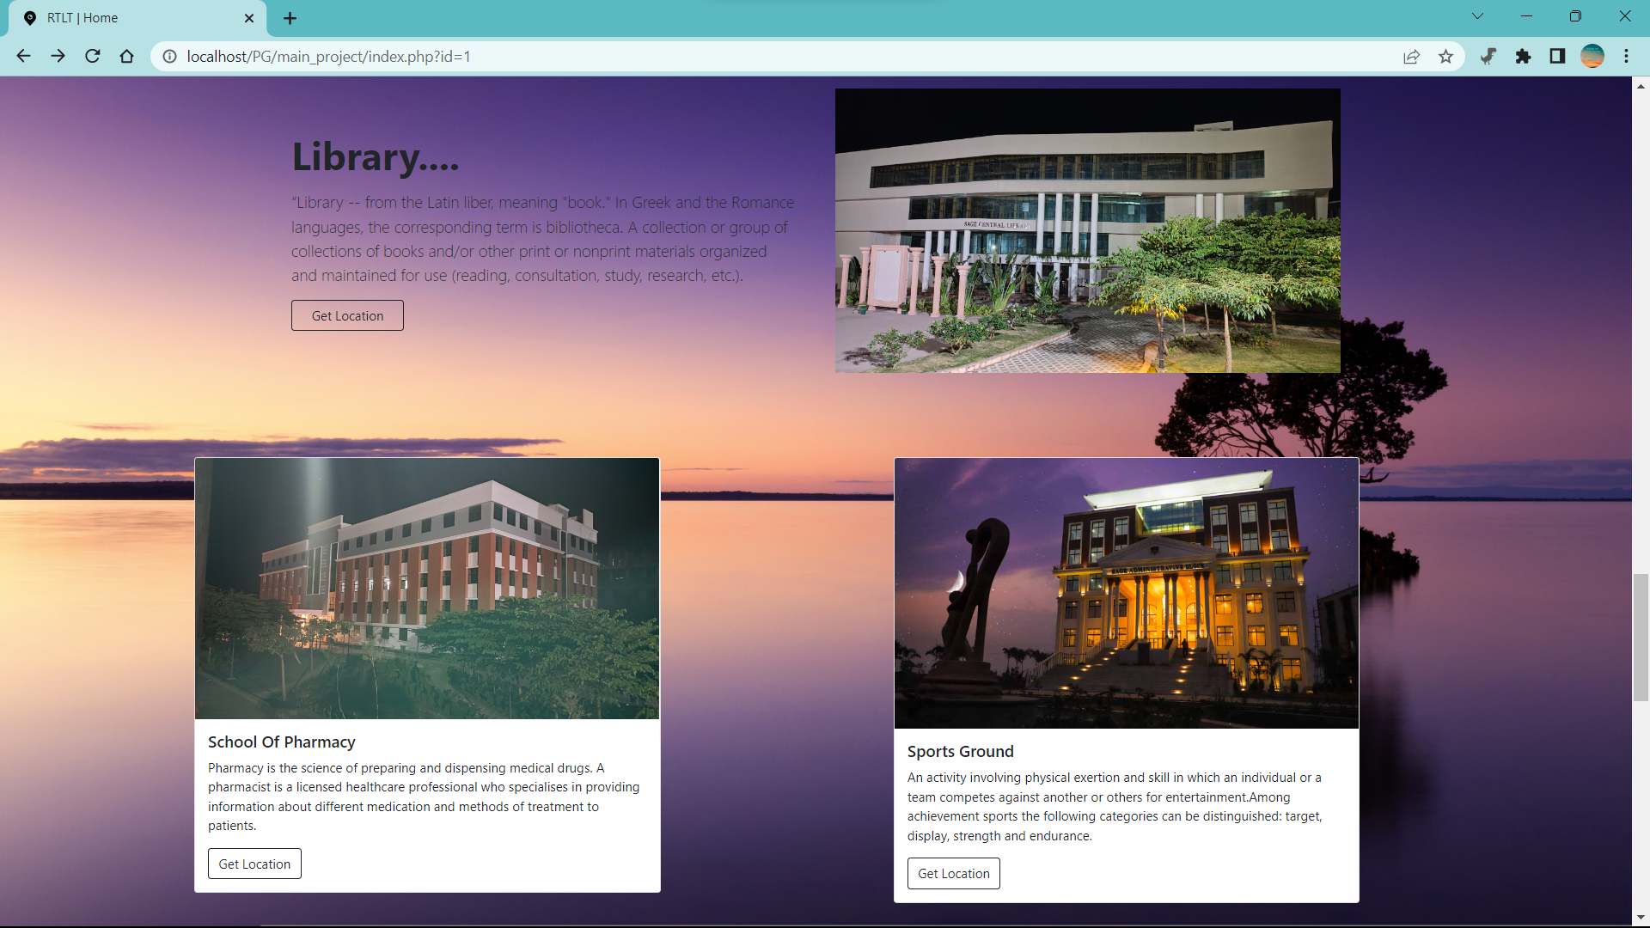
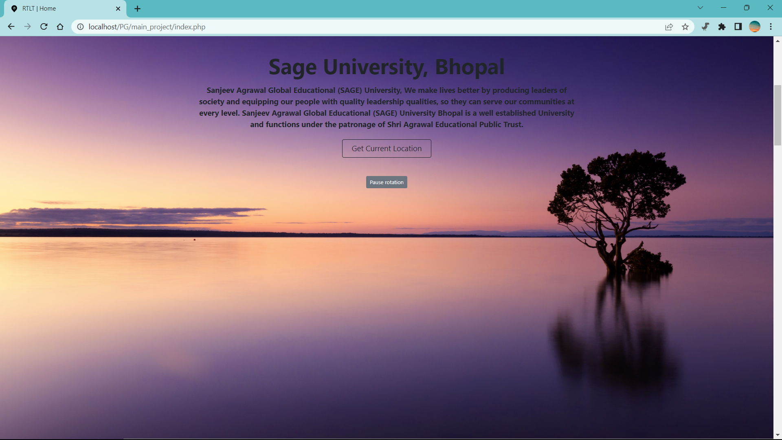
Snapshots of system

Slide 9

Conclusion
By the use of our website nobody can faces problem in college visits they simply can go anywhere in university without difficulty.

Slide 10

Future Work
There Is NO More Future Work On This Site

Slide 11

References
(Google Maps API : ) https://mapsplatform.google.com/maps-products/#embed
(MapBox Maps API : ) https://account.mapbox.com/
(Opencagedata API : ) https://opencagedata.com/api#quickstart
(Bootstrap Framework : ) https://getbootstrap.com/docs/5.1/
(Google Maps : ) https://www.google.com/maps/@23.1807395,77.5275458,15z
(W3school : ) https://www.w3schools.com/
Technology
HTML 5
CSS 3
JAVASCRIPT
GET BOOTSTRAP
AJAX
PHP
Database – MySql
API’s

